Slide 1

IT2060
Operating Systems and System Administration
Lecture 02
Introduction to Operating Systems

Slide 2
Content
Storage Structure
Booting Up process
Multiprocessor System
Interrupts handling
Operating System Structures

Slide 3
Storage Structure
Storage systems are organized in hierarchy in terms of:
Speed
Cost
Volatility
Size/capacity
Registers
volatile
Cache
Main Memory
Solid state Disks
Magnetic Disks
Optical Disks
Non-
volatile
Magnetic Tapes

Slide 4
Computer Startup
Booting Up the Computer: Booting is a process or set of operations that loads and hence starts the operating system, starting from the point when user switches on the power button.
bootstrap program is loaded at power-up or reboot
  Typically stored in ROM or EPROM, generally known as firmware
  Initializes all aspects of system
  Loads operating system kernel and starts execution

Slide 5
User press the start buttons
Electric signal
Power Supply
Wake up
signal
CPU
CMOS Battery
Access to fix address
FFFFF
CMOS Memory
Power on self Test
(POST)
ROM
(Firmware)
(BIOS)
Bootstrap Load
Results
Load & execute the
Bootstrap Load
Pass
Fail
Generate the Beep sound and display the error
Load MBR
Hard Disk
Stat OS

Slide 6
Computer-System Architecture
A single-processor system contains only one CPU to execute general purpose instructions
  However, it also contains special purpose processors
    E.g., disk, keyboard, DMA, graphic controllers
    These specialized processors do not run user processes
    OS may be able to manage the processors, e.g., task disk controllers to use given scheduling algorithms.
A multiprocessor system contains two or more processors working together
  They may share computer bus, system clock, memory, I/O devices
  Also called parallel system or multicore system

Slide 7
Multiprocessor (cont. )
Three main advantages of multiprocessor system
  Increased throughput: get more work done in less time
    The speed up in n processor system is NOT n due to overhead
  Economy of scale: I/O devices, memory storage, and power supplies can be shared
  Increased reliability: failure of one processor does not make the whole system down
    Graceful degradation: the system can perform operations proportional to the level of operations of the surviving parts of the system
    Fault-tolerant: the system can continue its function in the event of component failures
      Require failure detection, diagnoses, and even correction
      May use multiple hardware and software duplicates to execute the same tasks in parallel, and take as output the result from the majority of the duplicates

Slide 8
Multiprocessor (cont.)
Two types of multiprocessor system:
  Asymmetric multiprocessing
  Symmetric multiprocessing (SMP)
Asymmetric multiprocessing:
  Use a master processor to schedule and allocate work to (slave) processors.
  Each slave processor waits for instruction from the master or has predefined task
  More common in extremely large systems

Slide 9
Multiprocessor Systems (cont. )
SMP – not the master-slave model; a more common system
  Each processor runs an identical copy of the OS.
  Each processor has its own registers and cache
    However, they share the same memory
  Many processes can run at once without significant performance deterioration
    Need load balancing to improve performance
Symmtric and Asymmetric may be the result of either hardware or software.

Slide 10
Clustered Systems
A clustered system consists of multiple CPUs, like multiprocessors
  However, they are individual systems or nodes
  Each node can be a single processor or a multicore
  They share storage and communicate via LAN
  It offers high-availability service

Slide 11
Interrupts
Interrupts are signals sent to the CPU by external devices, normally I/O devices. They tell the CPU to stop its current activities and execute the appropriate part of the operating system.
There are three types of interrupts:
Hardware Interupts are generated by hardware devices to signal that they need some attention from the OS. They may have just received some data (e.g., keystrokes on the keyboard or an data on the ethernet card); or they have just completed a task which the operating system previous requested, such as transfering data between the hard drive and memory.
Software Interupts are generated by programs when they want to request a system call to be performed by the operating system.
Traps are generated by the CPU itself to indicate that some error or condition occured for which assistance from the operating system is needed.

Slide 13
Interrupt Handling
Common functions of interrupts
An interrupt is an event that suspends the execution of one program and begins the execution of another program.
For each type of interrupt, separate segments of code in the OS must determine what action should be taken
This code is called INTERRUPT SERVICE ROUTINE.
Associated with each I/O device there is a location near the bottom of memory called INTERRUPT VECTOR
This contains the address of the interrupt service routine for the various devices.

Slide 14
Interrupt Handling
When an interrupt (or trap) , hardware transfers control to OS
The OS preserves the state of the CPU by storing registers and the Program Counter.
Separate segments of code (Interrupt Service Routine) determine what action should be taken for each type of interrupt.

Slide 15
Intel Pentium interrupt vector table
Figure 13.4 (textbook)

Slide 16
Operating System Structure
General-purpose OS is very large program
Various ways to structure ones
  Simple structure – MS-DOS
  More complex -- UNIX
  Layered – an abstraction
  Microkernel -Mach

Slide 17
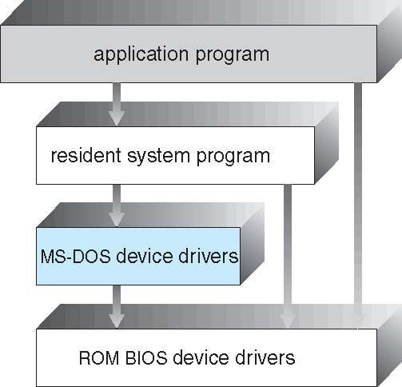
Simple Structure -- MS-DOS
MS-DOS – written to provide the most functionality in the least space
  Not divided into modules
  Although MS-DOS has some structure, its interfaces and levels of functionality are not well separated

Slide 18
Non Simple Structure -- UNIX
UNIX – limited by hardware functionality, the original UNIX operating system had limited structuring. The UNIX OS consists of two separable parts
  Systems programs
  The kernel
    Consists of everything below the system-call interface and above the physical hardware
    Provides the file system, CPU scheduling, memory management, and other operating-system functions; a large number of functions for one level

Slide 19
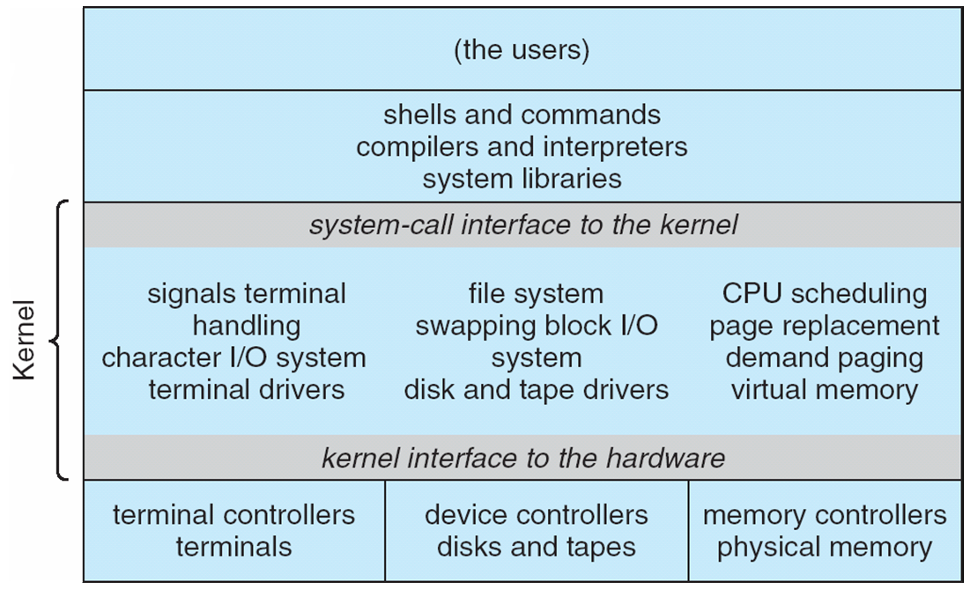
Traditional UNIX System Structure
Beyond simple but not fully layered

Slide 20
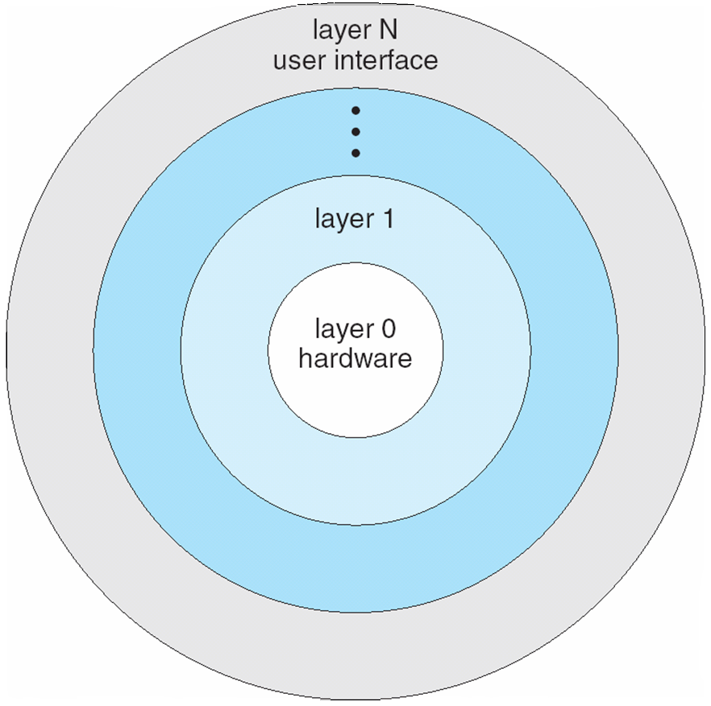
Layered Approach
The operating system is divided into a number of layers (levels), each built on top of lower layers. The bottom layer (layer 0), is the hardware; the highest (layer N) is the user interface.
With modularity, layers are selected such that each uses functions (operations) and services of only lower-level layers

Slide 21
Microkernel System Structure
Moves as much from the kernel into user space
Mach example of microkernel
  Mac OS X kernel (Darwin) partly based on Mach
Communication takes place between user modules using message passing
Benefits:
  Easier to extend a microkernel
  Easier to port the operating system to new architectures
  More reliable (less code is running in kernel mode)
  More secure
Detriments:
  Performance overhead of user space to kernel space communication

Slide 22
Microkernel System Structure

Slide 23
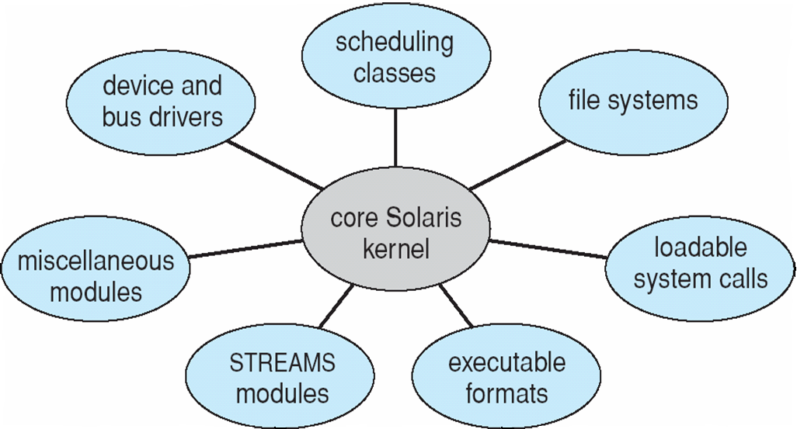
Modules
Many modern operating systems implement loadable kernel modules
  Uses object-oriented approach
  Each core component is separate
  Each talks to the others over known interfaces
  Each is loadable as needed within the kernel
Overall, similar to layers but with more flexible
  Linux, Solaris, etc

Slide 24
End of Lecture 2

